Slide 1

Thursday, July16th, 2020
Topic: Types of Network
Objectives:
To identify the different types of network and how they work.
To identify the advantages and disadvantages of each network.

Slide 2
What´s a computer Network?
A computer network, also referred to as a data network, is a series of interconnected nodes that can transmit, receive and exchange data, voice and video traffic. Examples of nodes in a network include servers or modems. Computer networks commonly help endpoint users share resources and communicate.

Slide 3
Types of Networks in Use Today
Local Area Network (LAN)
Wide Area Network (WAN)
Metropolitan Area Network (MAN)
Campus Area Network (CAN)
Storage-Area Network (SAN)
Virtual Private Network (VPN)
Personal Area Network (PAN)
Wireless Local Area Network (WLAN)

Slide 4
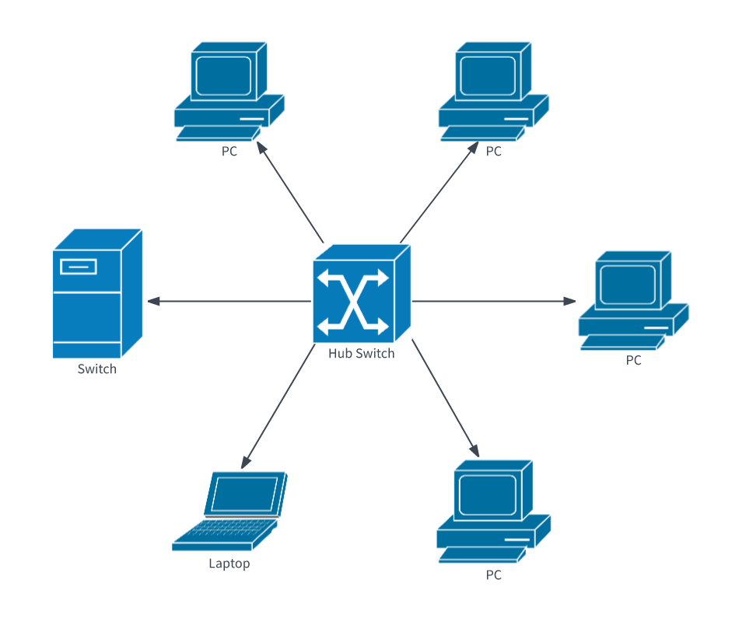
Local Area Network (LAN)
LANs are the most frequently discussed networks, one of the most common, one of the most original and one of the simplest types of networks. LANs connect groups of computers and low-voltage devices together across short distances (within a building or between a group of two or three buildings in close proximity to each other) to share information and resources. Enterprises typically manage and maintain LANs.

Slide 5
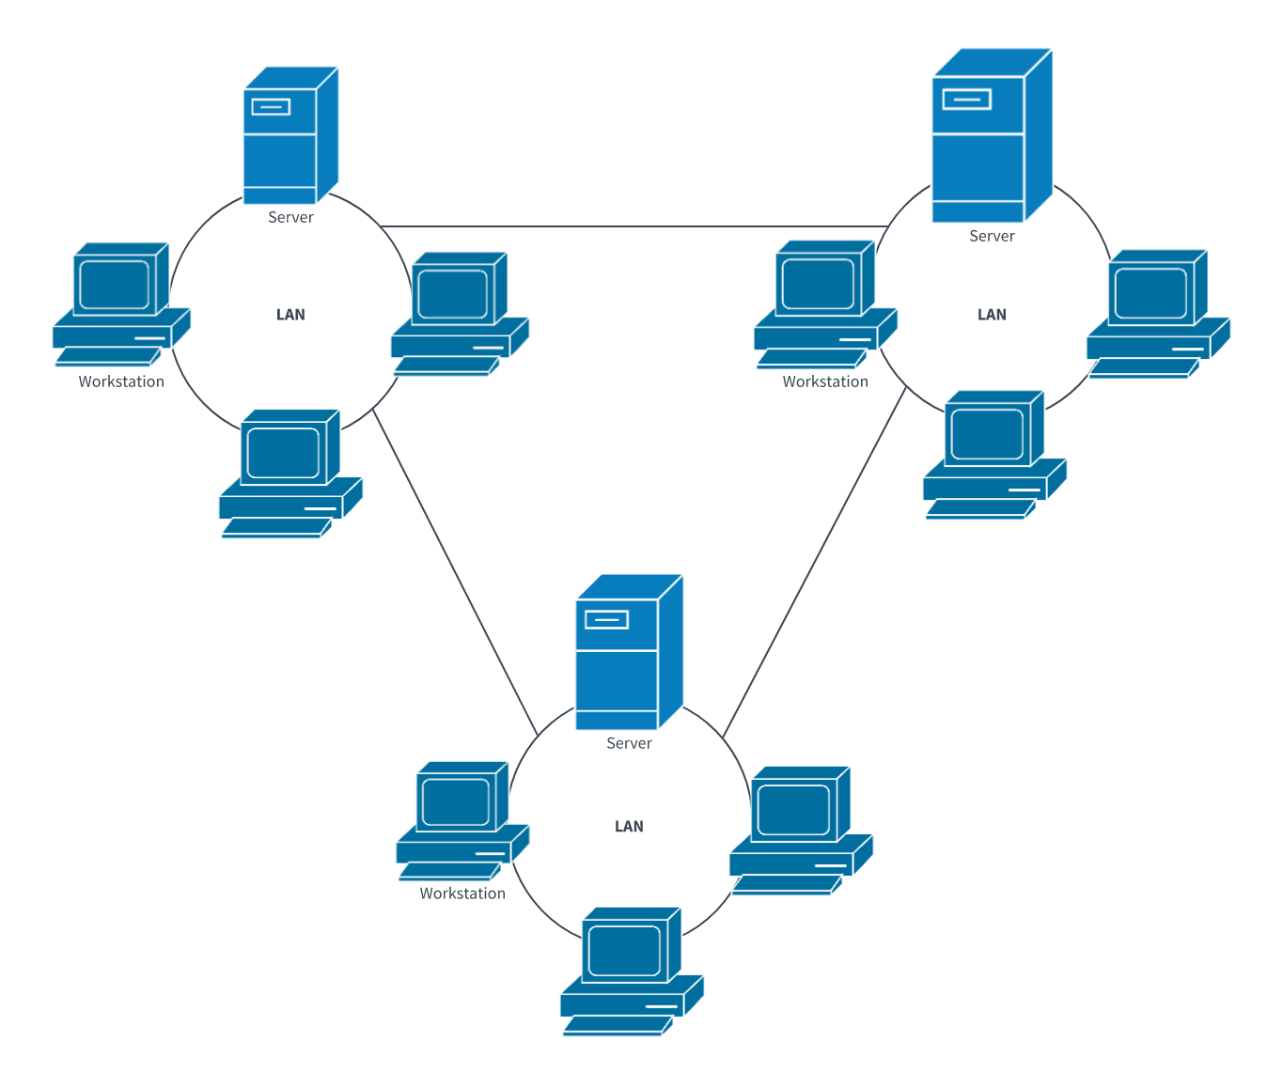
Wide Area Network (WAN)
Slightly more complex than a LAN, a WAN connects computers together across longer physical distances. This allows computers and low-voltage devices to be remotely connected to each other over one large network to communicate even when they’re miles apart.
The Internet is the most basic example of a WAN, connecting all computers together around the world.

Slide 6
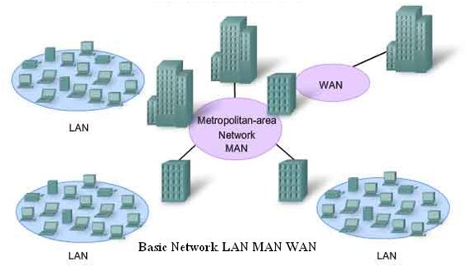
Metropolitan Area Network (MAN)
These types of networks are larger than LANs but smaller than WANs – and incorporate elements from both types of networks. MANs span an entire geographic area (typically a town or city, but sometimes a campus). Ownership and maintenance is handled by either a single person or company (a local council, a large company, etc.).

Slide 7
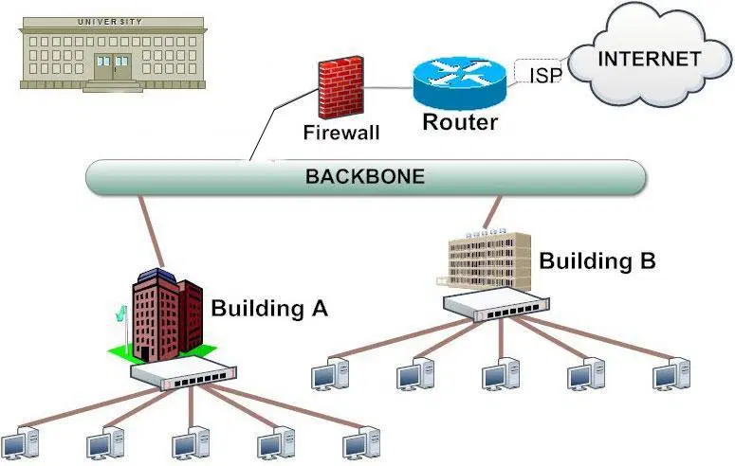
Campus Area Network (CAN)
Larger than LANs, but smaller than metropolitan area networks (MANs, explained below), these types of networks are typically seen in universities, large K-12 school districts or small businesses. They can be spread across several buildings that are fairly close to each other so users can share resources.

Slide 8
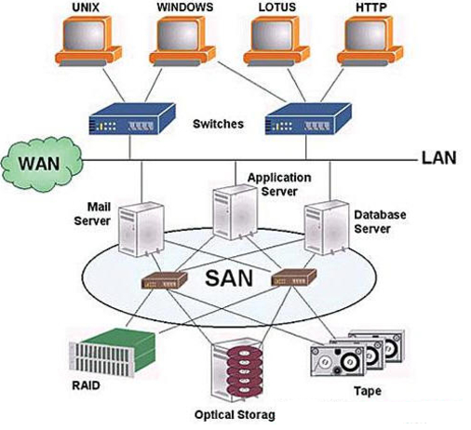
Storage-Area Network (SAN)
As a dedicated high-speed network that connects shared pools of storage devices to several servers, these types of networks don’t rely on a LAN or WAN. Instead, they move storage resources away from the network and place them into their own high-performance network. SANs can be accessed in the same fashion as a drive attached to a server.

Slide 9
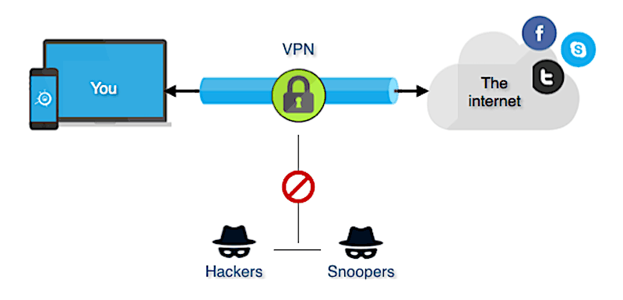
Virtual Private Network (VPN)
By extending a private network across the Internet, a VPN lets its users send and receive data as if their devices were connected to the private network – even if they’re not. Through a virtual point-to-point connection, users can access a private network remotely.

Slide 10
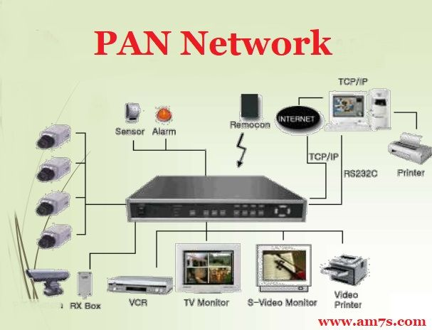
Personal Area Network (PAN)
The smallest and most basic type of network, a PAN is made up of a wireless modem, a computer or two, phones, printers, tablets, etc., and revolves around one person in one building. These types of networks are typically found in small offices or residences, and are managed by one person or organization from a single device.

Slide 11
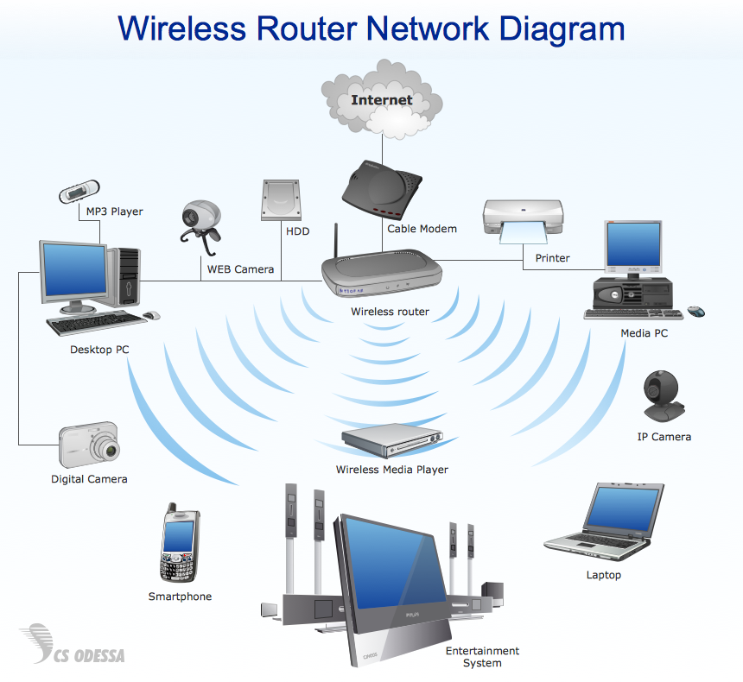
Wireless Local Area Network (WLAN)
Functioning like a LAN, WLANs make use of wireless network technology, such as Wi-Fi. Typically seen in the same types of applications as LANs, these types of networks don’t require that devices rely on physical cables to connect to the network.

